Slide 1

Spark架构及内部实现剖析

Slide 2
主要内容
1
核心概念
2
内部原理
3
运行模式
4
总结

Slide 3
主要内容
1
核心概念
2
内部原理
3
运行模式
4
总结

Slide 4
Spark核心概念—RDD
RDD：Resilient Distributed Datasets，弹性分布式数据集
分布在集群中的只读对象集合（由多个Partition构成）
可以存储在磁盘或内存中（多种存储级别）
通过并行“转换”操作构造
失效后自动重构

Slide 5
RDD基本操作（operator）
Transformation（转换）
可通过Scala集合或者Hadoop数据集构造一个新的RDD
通过已有的RDD产生新的RDD
举例：map， filter，groupBy，reduceBy
Action（行动）
通过RDD计算得到一个或者一组值
举例：count，collect，save

Slide 6
Operator示例
RDD 1
Operation
RDD 2
Operation
Storage System
1
2
3
2
3
4
map( + 1 )
saveASTEXTFILE(“HDFS://…”)
HDFS
4
5
5
6
partitions
6
7
7
8
作用在RDD上的operation

Slide 7
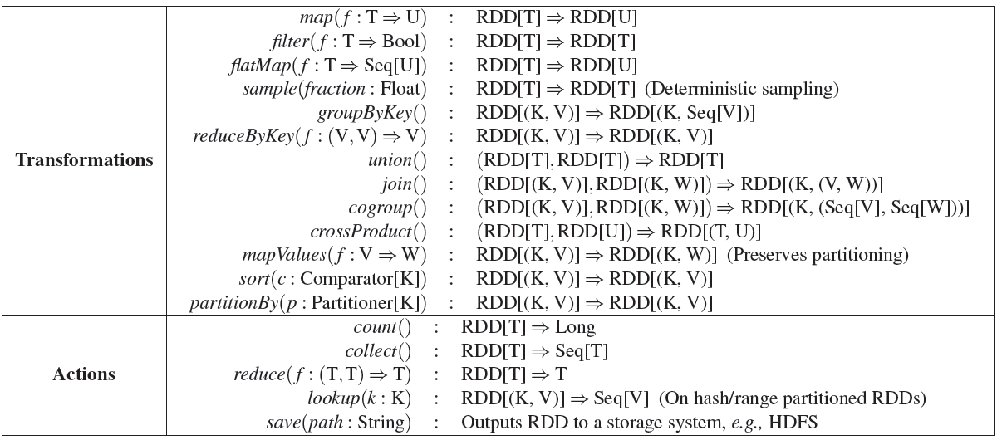
Transformation与Action实现

Slide 8
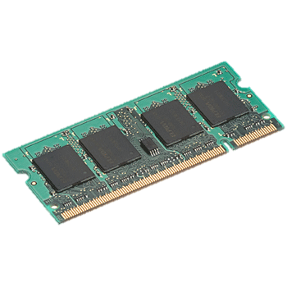
Transformation与Action实现
query 1
one-time processing
query 2
query 3
Input
Distributed memory
. . .
storage levels
MEMORY_ONLY
MEMORY_ONLY_2
MEMORY_AND_DISK
…….
beacons = spark.textFile(“hdfs://...”)
cachedBeacons = beacons.cache()
cachedBeacons.filter(_.contains(“HouseOfCards”)).count
cachedBeacons.filter(_.contains(“GameOfThrone”)).count
……

Slide 9
一个完整的实例
import org.apache.spark._
import SparkContext._
object WordCount {
def main(args: Array[String]) {
if (args.length != 3 ){
println("usage is org.test.WordCount <master> <input> <output>")
return
}
val sc = new SparkContext(args(0), "WordCount",
System.getenv("SPARK_HOME"), Seq(System.getenv("SPARK_TEST_JAR")))
val textFile = sc.textFile(args(1))
val result = textFile.flatMap(line => line.split("\\s+"))
.map(word => (word, 1)).reduceByKey(_ + _)
result.saveAsTextFile(args(2))
}
}
Master地址
作业名称
依赖的jar包
Spark安装
目录
输入数据所在目录，比如:
hdfs://host:port/input/data
数据输出目录，比如:
hdfs://host:port/output/data

Slide 10
主要内容
1
核心概念
2
内部原理
3
运行模式
4
总结

Slide 11
Spark内部原理
为DAG生成物理查询计划
调度并执行Task
通过RDD，创建DAG
Execution
Physical
Logic

Slide 12
Spark内部原理
RDD Objects
DAGScheduler
TaskScheduler
Worker
Cluster manager
Threads
DAG
TaskSet
Task
Block manager
rdd1.join(rdd2) .groupBy(…)
.filter(…)
将图分解成一系列stage，每个stage由若干task个构成
将task提交到集群中
通过cluster manager提交作业
执行task
重新提交失败的task或拖后腿task
存储block，提供block读写服务
构造操作符DAG

Slide 13
wordcount—生成逻辑查询计划
val textFile = sc.textFile(args(1))
val result = textFile
.flatMap(line => line.split("\\s+"))
.map(word => (word, 1))
.reduceByKey(_ + _)
result.saveAsTextFile(args(2))
RDD[String]
RDD[String]
RDD[(String, Int)]
RDD[(String, Int)]
HDFS
HDFS
textFile
flatMap
map
reduceByKey

Slide 14
wordcount—生成逻辑查询计划
HDFS
HDFS
textFile
flatMap
map
reduceByKey
Stage 1
Stage 2
HDFS
HDFS
textFile
flatMap
map
reduceByKey

Slide 15
wordcount—生成物理查询计划
Stage 1
Stage 2
HDFS
HDFS
textFile
flatMap
map
reduceByKey
Stage 1
Stage 2
并行从HDFS上读取数据进行处理
从Stage1上获取数据，并行处理后，写回HDFS

Slide 16
wordcount—调度并执行task
Stage 1
Stage 0
Task
Task
Driver
result
Task
Task
Task
Block
ShuffleFile
Executor
Task
task
Task
result
Task
Task
task
result
task
Task
Block
ShuffleFile
Executor
Task
Block
ShuffleFile
Executor

Slide 17
wordcount—问题讨论
Stage 1
Stage 0
Spark中task类型
ShuffleMapTask
ResultTask
每个stage的task数目?
First Stage: 由hdfs block或hbase regioin数目决定
Other Stages: 由用户设置，默认与第一个阶段相等
Task
Task
Task
Task
Task
Task
Task

Slide 18
Spark中基本概念总结
Task：计算基本单元
Stage：由一系列可以并行执行的Task构成
DAG：RDD操作符组成的逻辑执行图
RDD：由若干分片（Partition）组成的并行数据集

Slide 19
MapReduce核心计算—shuffle
map phase
partition sort combie phase
copy phase
merge sort phase
reduce phase
MapTask
ReduceTask
partition, sort, combine and spill to disk
remote fetch
merge
reduce
output
input split
map
merge on disk
buffer in memory
merge
merge
partitions
memory and disk
other mappers
other reducers

Slide 20
Spark核心计算—shuffle
reduceByKey(_ + _)
Shuffle Write
User RDD
MapPartitionsRDD
ShuffleRDD
MapPartitionsRDD
Local Combine
shuffle
aggregate
P
P
P
P
P
P
P
P
P
P

Slide 21
Spark核心计算—shuffle write
Core 1
Core 2
Map Task 1
Map Task 3
Map Task 2
Map Task 4
File
File
File
File
File
File
File
File
File
File
File
File
bucket
bucket
bucket
bucket
bucket
bucket
bucket
bucket
bucket
bucket
bucket
bucket
K5, V5
unsorted
partitioned
K1, V1
K3, V3
K5, V6
…
Reduce Task
Reduce Task
Reduce Task

Slide 22
Spark核心计算—shuffle write
Total shuffle file number
M * R
1million files, if 1k mapper and 1k reducer
Write buffer size
Core * R * 32k
256 MB, if 8 cores and 1000 reducer

Slide 23
Spark核心计算—shuffle write
Map Task 1
Map Task 2
Core 1
Core 2
Map Task 3
Map Task 4
File
File
File
File
File
File
bucket
bucket
bucket
bucket
bucket
bucket
bucket
bucket
bucket
bucket
bucket
bucket
K5, V5
unsorted
K1, V1
K3, V3
K5, V6
…
Reduce Task
Reduce Task
Reduce Task

Slide 24
Spark核心计算—shuffle write
Total shuffle file number (improved)
M * R
Write buffer size (same)
Core * R * 32k
Core * R

Slide 25
Spark核心计算—shuffle read
reduceByKey(_ + _)
Shuffle
Read
User RDD
MapPartitionsRDD
ShuffleRDD
MapPartitionsRDD
Local Combine
shuffle
aggregate
P
P
P
P
P
P
P
P
P
P

Slide 26
Spark核心计算—shuffle read
MapPartitionsRDD
ShuffleRDD
shuffleRead
P
bucket
bucket
bucket
bucket
bucket
P
P
bucket
bucket
bucket
P
bucket
P
bucket
bucket
bucket
K5, V5
K5, V5
unsorted
K3, V3
unsorted
K3, V3
K1, V1
K1, V1
K5, V6
K5, V6
…
…

Slide 27
Spark核心计算—aggregate
reduceByKey(_ + _)
Aggregate
User RDD
MapPartitionsRDD
ShuffleRDD
MapPartitionsRDD
Local Combine
shuffle
aggregate
P
P
P
P
P
P
P
P
P
P

Slide 28
Spark核心计算—aggregate
ShuffleRDD
MapPartitionsRDD
P
P
P
P
K5, V5
K3, f(values)
unsorted
partitioned
K1, V1
K1, f(values)
aggregate
K3, V3
K5, f(values)
K5, V6
…
…

Slide 29
Spark核心计算—aggregate
hash
map.put(key, f(value, map.get(key)))
K5, V5
HashMap
unsorted records
K1, V1
K3, f(values)
aggregate
K3, V3
K1, f(values)
K5, V6
K3, V3
K5, f(values)
…
…
K1, V1
K5, f(V5, V6)
…
function should be Commutative and Associative

Slide 30
Spark核心计算—aggregate
Memory not enough?
HashMap
HashMap
HashMap
HashMap
K1, V1
K3, V3
sort
K3, V3
new
put
K3, V33
K5, V5
…
K1, V1
K1, V11
Memory
K5, V5
K5, V55
…
…
…
…
spill to disk
spill to disk
Disk
K1, V1
K1, V11
K3, V3
K3, V33
K5, V5
K5, V55

Slide 31
Spark核心计算—aggregate
Memory not enough?
output
K1, f(V1, V11)
Memory
merge combine
Disk
K1, V1
K1, V11
K3, V3
K3, V33
K5, V5
K5, V55

Slide 32
Spark核心计算—aggregate
ShuffleRDD
MapPartitionsRDD
mapPartitions()
P
P
P
P
map.put(key, f(value, map.get(key)))
K5, V5
HashMap
unsorted records
K1, V1
K3, f(values)
K3, V3
K1, f(values)
K5, V6
K3, V3
K5, f(values)
…
…
K1, V1
K5, f(V5, V6)
…

Slide 33
Spark核心计算—groupByKey
User RDD
ShuffleRDD
MapPartitionsRDD
1, a
2, b
1, a
2, b
1, d
1, d
1, (a, d, d)
2, (b)
1, d
3, e
3, e
3, f
3, (e, f)
1, d
3, f
No map-side combine

Slide 34
Spark核心计算—shuffle比较
 | Type | MapReduce | Spark 1.1
Map | sort | yes | sort
 | combine | optional | optional
 | shuffle file number | M | M
Reduce | sort | merge sort | no merge sort(1.2)
 | group key | sorted | hashmap sorted(1.2)

Slide 35
主要内容
1
核心概念
2
内部原理
3
运行模式
4
总结

Slide 36
Spark程序框架
Worker Node
Executor
Cache
Driver
Task
Task
SparkContext
Worker Node
Executor
Cache
Task
Task

Slide 37
程序原型模式：独立（Standlone）模式
zookeeper
Master
Master
Slave
Slave
Slave
Task
Task
Task
Task
Driver
Task
Task
Driver
Task
Task
Task
Task
Your Application
Task
Task
Your Application
Executor
Executor
Executor

Slide 38
程序原型模式：YARN分布式模式
Client
Client
ResourceManager
NodeManager
NodeManager
NodeManager
Task
Task
Task
Task
MRAppMaster
Task
Task
Driver
Task
Task
Task
Task
MR Application
Task
Task
App Master
Executor
Executor
Executor

Slide 39
Spark代码量
Spark: 20,000 LOC
Hadoop 1.0: 90,000 LOC
Hadoop 2.0: 220,000 LOC

Slide 40
Spark生态系统代码量
Spark core: 16,000 LOC
Interpreter: 3300 LOC
Operators: 2000
Scheduler: 2500
Block manager: 2700
Networking: 1200
Accumulators: 200
Broadcast: 3500
Hadoop I/O: 400 LOC
Mesos backend: 700 LOC
Standalone backend: 1700 LOC

Slide 41
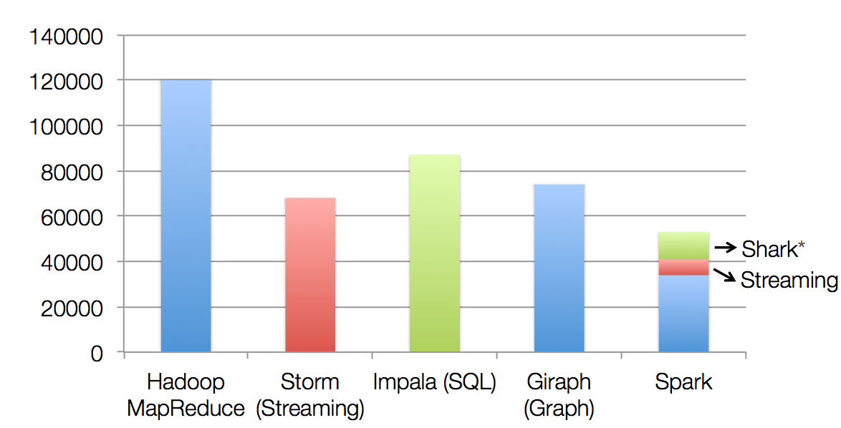
Spark生态系统代码量
non-test, non-example source lines
* also calls into Hive

Slide 42
Spark生态系统
Shark
SQL
Spark
Streaming
Graphx
Graph-parallel
MLBase
Machine
learning
MPI
MapReduce
Spark
Mesos
YARN
Tachyon
HDFS

Slide 43

总结与提问

